Slide 1
Deep Learning from Scratch
Theory + Practical
FAHAD HUSSAIN
MCS, MSCS, DAE(CIT)
Computer Science Instructor of well known international Center
Also, Machine Learning and Deep learning Practitioner
For further assistance, code and slide https://fahadhussaincs.blogspot.com/
YouTube Channel : https://www.youtube.com/fahadhussaintutorial

Slide 2

AI vs ML vs DL
For further assistance, code and slide https://fahadhussaincs.blogspot.com/
YouTube Channel : https://www.youtube.com/fahadhussaintutorial

Slide 3
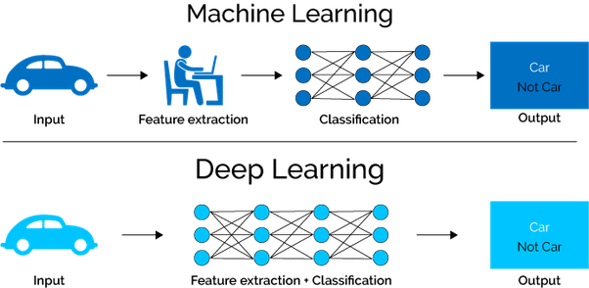
ML vs DL
For further assistance, code and slide https://fahadhussaincs.blogspot.com/
YouTube Channel : https://www.youtube.com/fahadhussaintutorial

Slide 4

So, What do you think, what is Deep Learning
Deep learning is a machine learning technique that learns features and task directly from the data, where data may by images, text or sound!
For further assistance, code and slide https://fahadhussaincs.blogspot.com/
YouTube Channel : https://www.youtube.com/fahadhussaintutorial

Slide 5
So, What we learn in this course
Artificial Neural Network
Convolutional neural network
Recurrent neural network
Boltzmann machine Vs Deep BM
Self organizing maps
Autoencoder
GAN (Generative Adversarial Network)
Deep Q Learning
Pre Train Model (CNN Architecture and many more…
Keras
Vs
TensorFlow
For further assistance, code and slide https://fahadhussaincs.blogspot.com/
YouTube Channel : https://www.youtube.com/fahadhussaintutorial

Slide 6
Thank You!
For further assistance, code and slide https://fahadhussaincs.blogspot.com/
YouTube Channel : https://www.youtube.com/fahadhussaintutorial

Slide 7
So, What we learn in this course
Supervised Unsupervised Reinforcement Learning
Artificial Neural Network
Regression and Classification
For further assistance, code and slide https://fahadhussaincs.blogspot.com/
YouTube Channel : https://www.youtube.com/fahadhussaintutorial

Slide 8
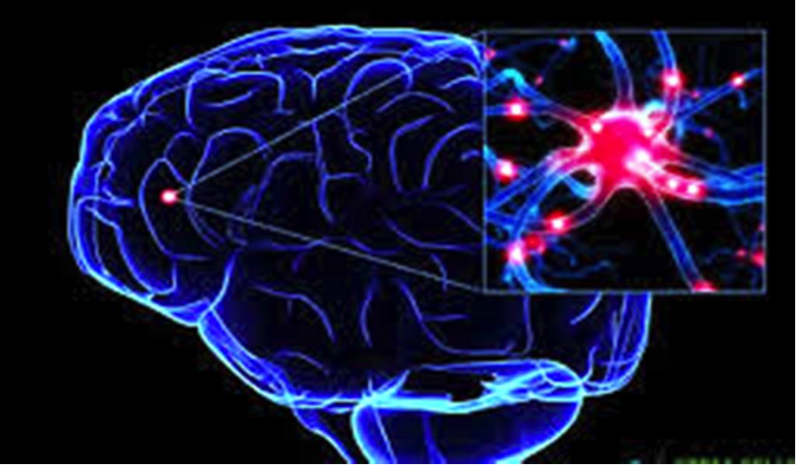
What is Neural
For further assistance, code and slide https://fahadhussaincs.blogspot.com/
YouTube Channel : https://www.youtube.com/fahadhussaintutorial

Slide 9
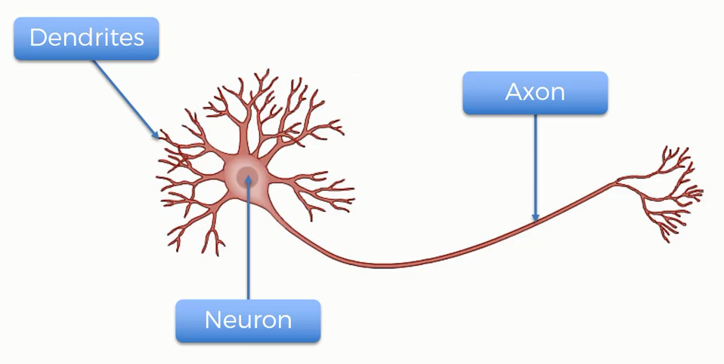
Neural Working
For further assistance, code and slide https://fahadhussaincs.blogspot.com/
YouTube Channel : https://www.youtube.com/fahadhussaintutorial

Slide 10
Perceptron in deep learning
For further assistance, code and slide https://fahadhussaincs.blogspot.com/
YouTube Channel : https://www.youtube.com/fahadhussaintutorial

Slide 11
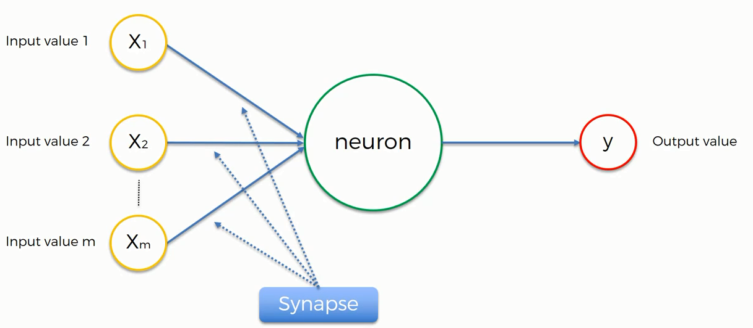
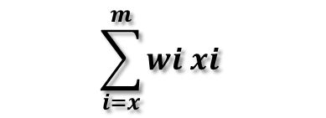
Artificial Neural Network
Normalize/Standardize
$$\sum_{i=x}^{m}{wi xi}$$
Applying Activation Function
For further assistance, code and slide https://fahadhussaincs.blogspot.com/
YouTube Channel : https://www.youtube.com/fahadhussaintutorial

Slide 12
Thank You!
For further assistance, code and slide https://fahadhussaincs.blogspot.com/
YouTube Channel : https://www.youtube.com/fahadhussaintutorial

Slide 13
Artificial Neural Network
Normalize/Standardize
$$\sum_{i=x}^{m}{wi xi}$$
Applying Activation Function
For further assistance, code and slide https://fahadhussaincs.blogspot.com/
YouTube Channel : https://www.youtube.com/fahadhussaintutorial

Slide 14
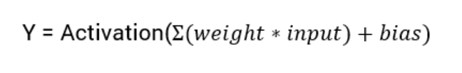
What is an Activation Function?
Activation functions are an extremely important feature of the artificial neural networks. They basically decide whether a neuron should be activated or not. Whether the information that the neuron is receiving is relevant for the given information or should it be ignored.
The activation function is the non linear transformation that we do over the input signal. This transformed output is then seen to the next layer of neurons as input.
Linear Activation Function
Non Linear Activation Function
For further assistance, code and slide https://fahadhussaincs.blogspot.com/
YouTube Channel : https://www.youtube.com/fahadhussaintutorial

Slide 15
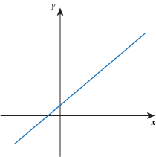
What is an Activation Function?
Linear Function
The function is a line or linear. Therefore, the output of the functions will not be confined between any range
Non Linear Function
Threshold
Sigmoid
Tanh
ReLU
Leaky ReLU
Softmax
They make it easy for the model to generalize or adapt with variety of data and to differentiate between the output
The Nonlinear Activation Functions are mainly divided on the basis of their range or curves
For further assistance, code and slide https://fahadhussaincs.blogspot.com/
YouTube Channel : https://www.youtube.com/fahadhussaintutorial

Slide 16
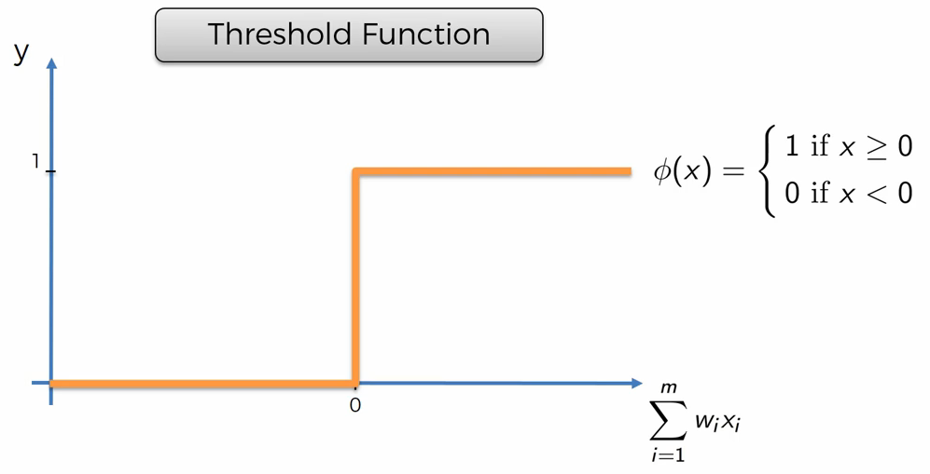
Threshold Function?
For further assistance, code and slide https://fahadhussaincs.blogspot.com/
YouTube Channel : https://www.youtube.com/fahadhussaintutorial

Slide 17
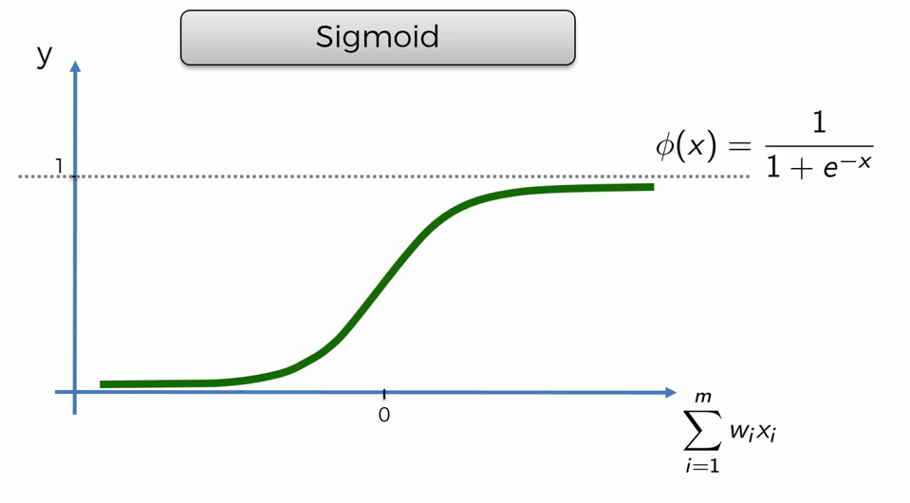
Sigmoid Function?
The Sigmoid Function curve looks like a S-shape
This function reduces extreme values or outliers in data without removing them.
It converts independent variables of near infinite range into simple probabilities between 0 and 1, and most of its output will be very close to 0 or 1.
For further assistance, code and slide https://fahadhussaincs.blogspot.com/
YouTube Channel : https://www.youtube.com/fahadhussaintutorial

Slide 18
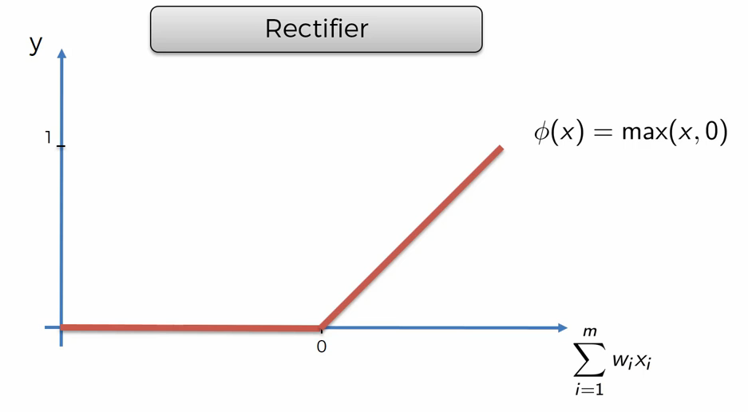
Rectifier (Relu) Function?
ReLU is the most widely used activation function while designing networks today. First things first, the ReLU function is non linear, which means we can easily backpropagate the errors and have multiple layers of neurons being activated by the ReLU function.
For further assistance, code and slide https://fahadhussaincs.blogspot.com/
YouTube Channel : https://www.youtube.com/fahadhussaintutorial

Slide 19
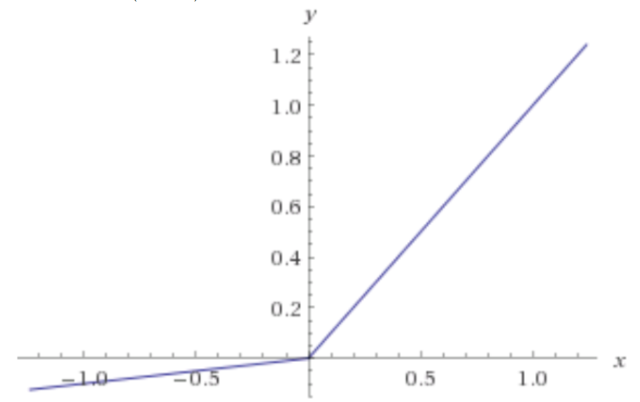
Leaky Relu Function?
Leaky ReLU function is nothing but an improved version of the ReLU function. As we saw that for the ReLU function, the gradient is 0 for x<0, which made the neurons die for activations in that region. Leaky ReLU is defined to address this problem. Instead of defining the Relu function as 0 for x less than 0, we define it as a small linear component of x.
What we have done here is that we have simply replaced the horizontal line with a non-zero, non-horizontal line. Here a is a small value like 0.01 or so.
For further assistance, code and slide https://fahadhussaincs.blogspot.com/
YouTube Channel : https://www.youtube.com/fahadhussaintutorial

Slide 20
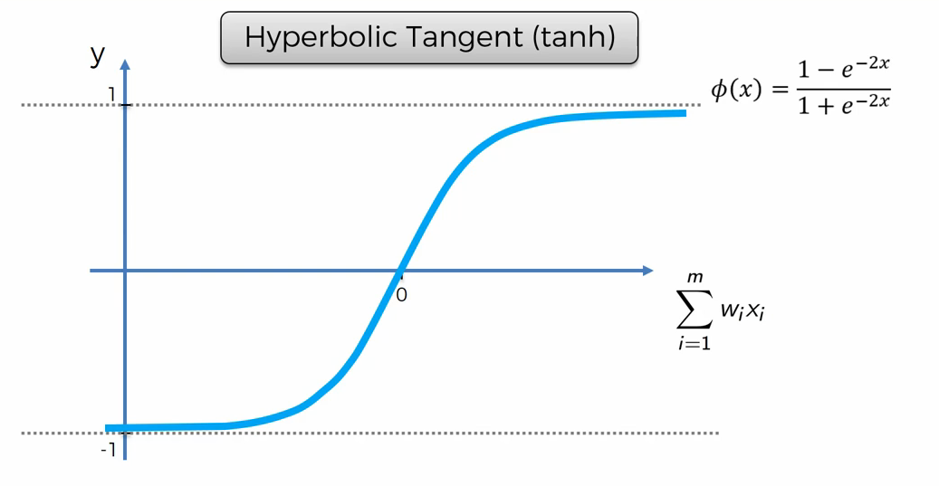
Sigmoid Function?
Pronounced “tanch,” tanh is a hyperbolic trigonometric function
The tangent represents a ratio between the opposite and adjacent sides of a right triangle, tanh represents the ratio of the hyperbolic sine to the hyperbolic cosine: tanh(x) = sinh(x) / cosh(x)
Unlike the Sigmoid function, the normalized range of tanh is –1 to 1 The advantage of tanh is that it can deal more easily with negative numbers
For further assistance, code and slide https://fahadhussaincs.blogspot.com/
YouTube Channel : https://www.youtube.com/fahadhussaintutorial

Slide 21
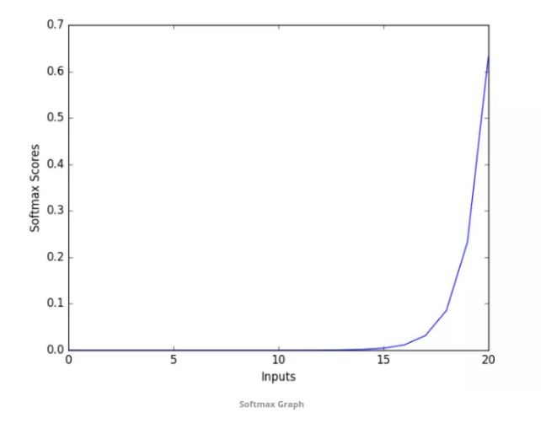
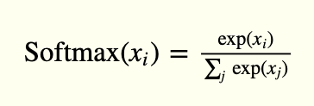
SoftMax Function (for Multiple Classification)?
SoftMax function calculates the probabilities distribution of the event over ‘n’ different events. In general way of saying, this function will calculate the probabilities of each target class over all possible target classes. Later the calculated probabilities will be helpful for determining the target class for the given inputs.
The main advantage of using SoftMax is the output probabilities range. The range will 0 to 1, and the sum of all the probabilities will be equal to one. If the SoftMax function used for multi-classification model it returns the probabilities of each class and the target class will have the high probability.
The formula computes the exponential (e-power) of the given input value and the sum of exponential values of all the values in the inputs. Then the ratio of the exponential of the input value and the sum of exponential values is the output of the SoftMax function.
For further assistance, code and slide https://fahadhussaincs.blogspot.com/
YouTube Channel : https://www.youtube.com/fahadhussaintutorial

Slide 22
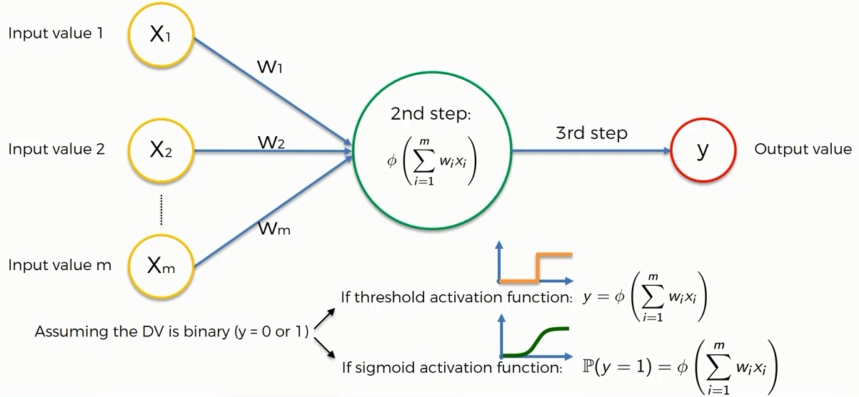
Activation Function Example
For further assistance, code and slide https://fahadhussaincs.blogspot.com/
YouTube Channel : https://www.youtube.com/fahadhussaintutorial

Slide 23
Thank You!
For further assistance, code and slide https://fahadhussaincs.blogspot.com/
YouTube Channel : https://www.youtube.com/fahadhussaintutorial

Slide 24
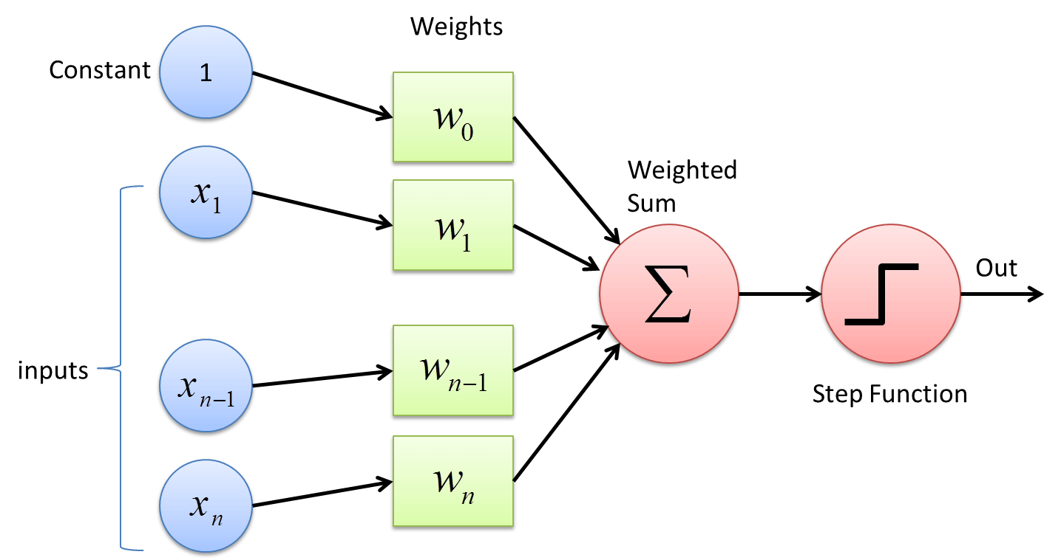
How Neural Network Work and Back Propagation in deep learning
For further assistance, code and slide https://fahadhussaincs.blogspot.com/
YouTube Channel : https://www.youtube.com/fahadhussaintutorial

Slide 25
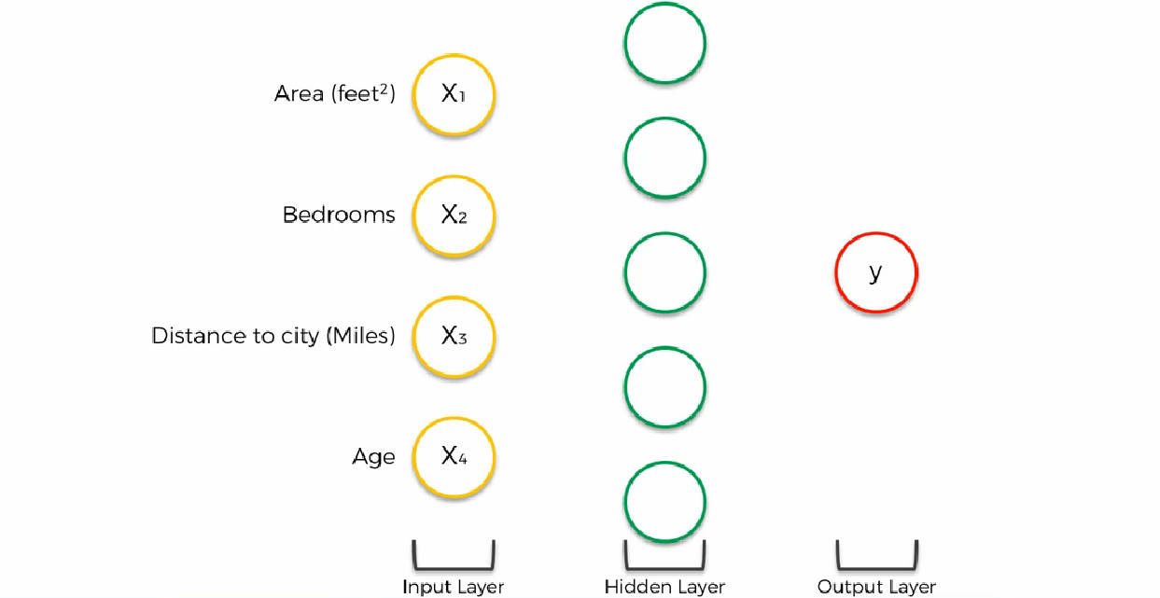
How Neural Network Work with many neurons
For further assistance, code and slide https://fahadhussaincs.blogspot.com/
YouTube Channel : https://www.youtube.com/fahadhussaintutorial

Slide 26
Back Propagation in deep learning
Back-propagation is the essence of neural net training. It is the method of fine-tuning the weights of a neural net based on the error rate obtained in the previous epoch (i.e., iteration). Proper tuning of the weights allows you to reduce error rates and to make the model reliable by increasing its generalization.
Backpropagation is a short form for "backward propagation of errors." It is a standard method of training artificial neural networks. This method helps to calculate the gradient of a loss function with respects to all the weights in the network.
For further assistance, code and slide https://fahadhussaincs.blogspot.com/
YouTube Channel : https://www.youtube.com/fahadhussaintutorial

Slide 27
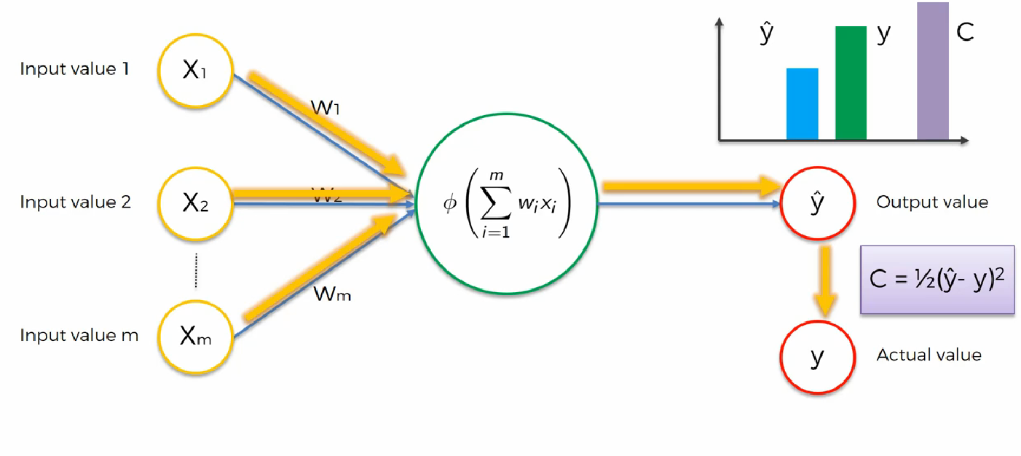
Back Propagation in deep learning
For further assistance, code and slide https://fahadhussaincs.blogspot.com/
YouTube Channel : https://www.youtube.com/fahadhussaintutorial

Slide 28
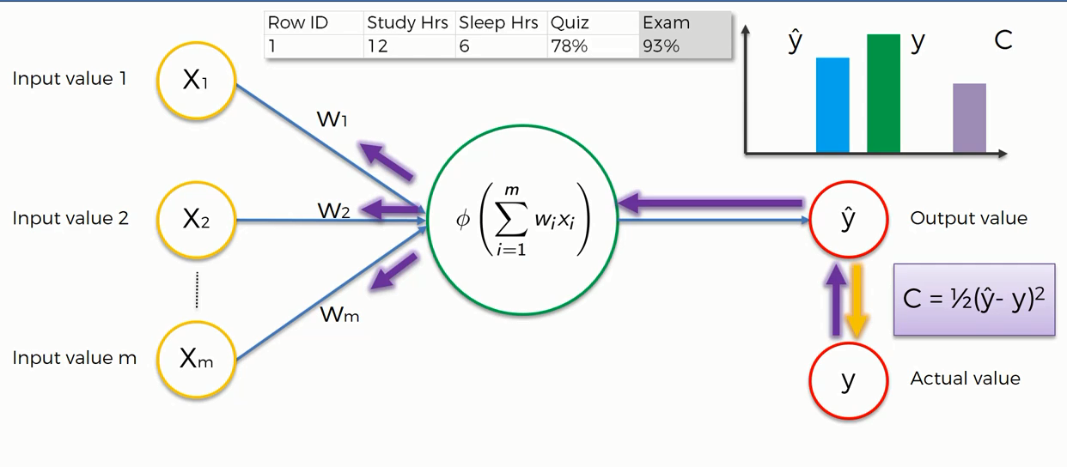
Back Propagation in deep learning
For further assistance, code and slide https://fahadhussaincs.blogspot.com/
YouTube Channel : https://www.youtube.com/fahadhussaintutorial

Slide 29
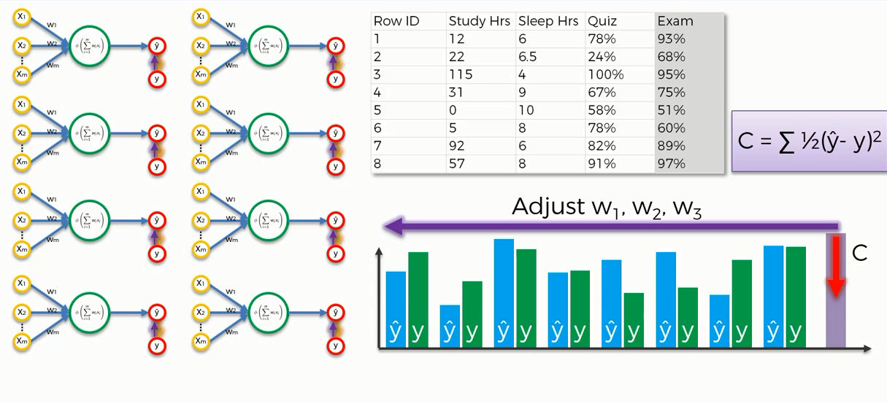
Back Propagation in deep learning (epoch)
For further assistance, code and slide https://fahadhussaincs.blogspot.com/
YouTube Channel : https://www.youtube.com/fahadhussaintutorial

Slide 30
For further assistance Visit Stack Exchange
https://stats.stackexchange.com/questions/154879/a-list-of-cost-functions-used-in-neural-networks-alongside-applications
For further assistance, code and slide https://fahadhussaincs.blogspot.com/
YouTube Channel : https://www.youtube.com/fahadhussaintutorial

Slide 31
Thank You!
For further assistance, code and slide https://fahadhussaincs.blogspot.com/
YouTube Channel : https://www.youtube.com/fahadhussaintutorial

Slide 32
Back Propagation in deep learning What is Bias Back Propagation (reduce Cost function) (Batch Gradient Descent, Stochastic Gradient Descent, Mini-batch Gradient Descent)
For further assistance, code and slide https://fahadhussaincs.blogspot.com/
YouTube Channel : https://www.youtube.com/fahadhussaintutorial

Slide 33
What is Bias
Bias is just like an intercept added in a linear equation. It is an additional parameter in the Neural Network which is used to adjust the output along with the weighted sum of the inputs to the neuron. Moreover, bias value allows you to shift the activation function to either right or left.
output = sum (weights * inputs) + bias
The output is calculated by multiplying the inputs with their weights and then passing it through an activation function like the Sigmoid function, etc. Here, bias acts like a constant which helps the model to fit the given data. The steepness of the Sigmoid depends on the weight of the inputs.
A simpler way to understand bias is through a constant c of a linear function
y =mx + c
For further assistance, code and slide https://fahadhussaincs.blogspot.com/
YouTube Channel : https://www.youtube.com/fahadhussaintutorial

Slide 34
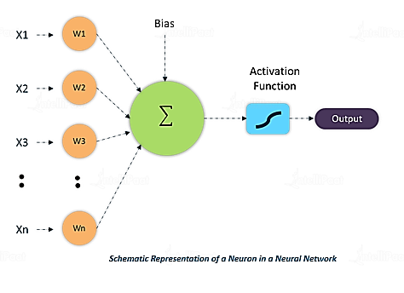
What is Bias
W * x + b
For further assistance, code and slide https://fahadhussaincs.blogspot.com/
YouTube Channel : https://www.youtube.com/fahadhussaintutorial

Slide 35
What is Gradient Descent (BGD)
Gradient Descent is an optimization technique that is used to improve deep learning and neural network-based models by minimizing the cost function.
Gradient Descent is a process that occurs in the backpropagation phase where the goal is to continuously resample the gradient of the model’s parameter in the opposite direction based on the weight w, updating consistently until we reach the global minimum of function J(w).
More Precisely,
Gradient descent is an algorithm, which is used to iterate through different combinations of weights in an optimal way.....to find the best combination of weights which has a minimum error.
For further assistance, code and slide https://fahadhussaincs.blogspot.com/
YouTube Channel : https://www.youtube.com/fahadhussaintutorial

Slide 36
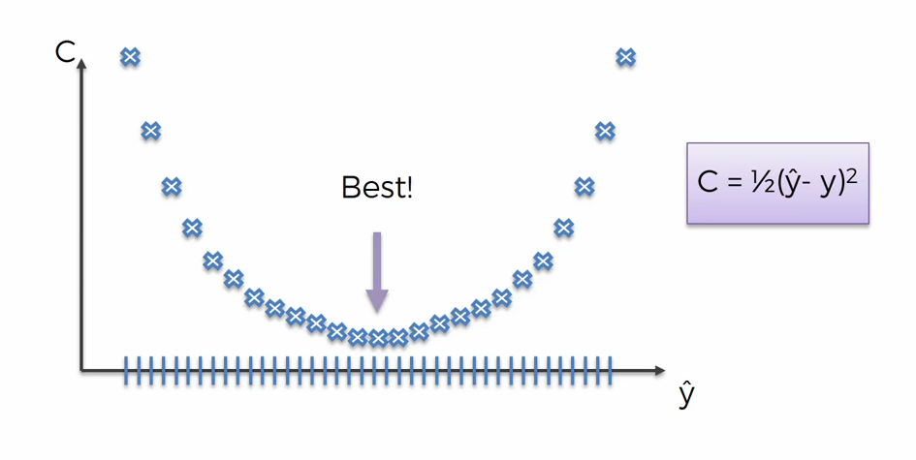
Brute force algorithm
Curse of dimensionality
Brute Force Algorithms refers to a programming style that does not include any shortcuts to improve performance, but instead relies on sheer computing power to try all possibilities until the solution to a problem is found. A classic example is the traveling salesman problem (TSP).
For further assistance, code and slide https://fahadhussaincs.blogspot.com/
YouTube Channel : https://www.youtube.com/fahadhussaintutorial

Slide 37
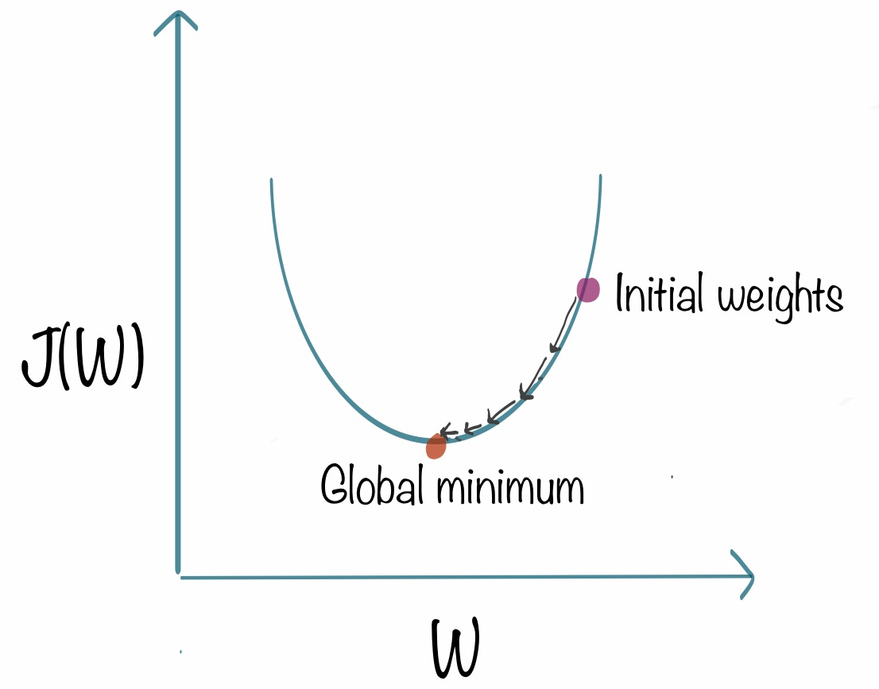
What is Gradient Descent
For further assistance, code and slide https://fahadhussaincs.blogspot.com/
YouTube Channel : https://www.youtube.com/fahadhussaintutorial

Slide 38
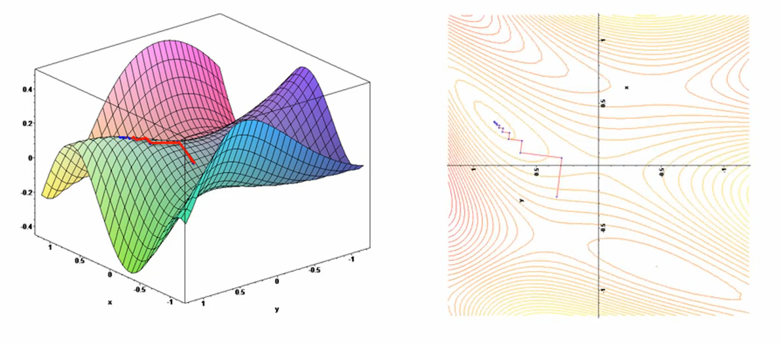
What is Gradient Descent
For further assistance, code and slide https://fahadhussaincs.blogspot.com/
YouTube Channel : https://www.youtube.com/fahadhussaintutorial

Slide 39
Useful link
https://towardsdatascience.com/understanding-the-mathematics-behind-gradient-descent-dde5dc9be06e
For further assistance, code and slide https://fahadhussaincs.blogspot.com/
YouTube Channel : https://www.youtube.com/fahadhussaintutorial

Slide 40
Thank You!
For further assistance, code and slide https://fahadhussaincs.blogspot.com/
YouTube Channel : https://www.youtube.com/fahadhussaintutorial

Slide 41
Stochastic gradient descent
The word ‘stochastic‘ means a system or a process that is linked with a random probability. Hence, in Stochastic Gradient Descent, a few samples are selected randomly instead of the whole data set for each iteration. In Gradient Descent, there is a term called “batch” which denotes the total number of samples from a dataset that is used for calculating the gradient for each iteration. In typical Gradient Descent optimization, like Batch Gradient Descent, the batch is taken to be the whole dataset. Although, using the whole dataset is really useful for getting to the minima in a less noisy or less random manner, but the problem arises when our datasets get really huge.
For further assistance, code and slide https://fahadhussaincs.blogspot.com/
YouTube Channel : https://www.youtube.com/fahadhussaintutorial

Slide 42
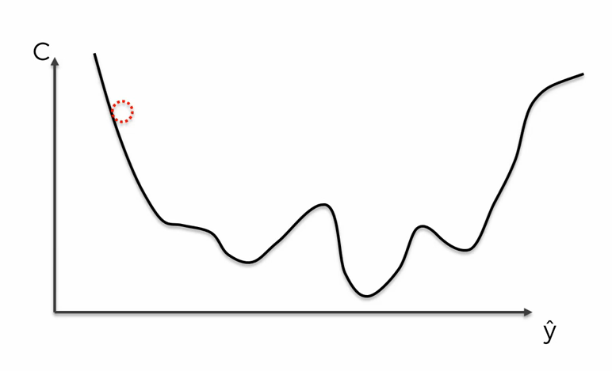
Stochastic gradient descent
Stochastic gradient descent (often abbreviated SGD) is an iterative method for optimizing an objective function with suitable smoothness properties (e.g. differentiable or subdifferentiable). ~Convex Loss function~
For further assistance, code and slide https://fahadhussaincs.blogspot.com/
YouTube Channel : https://www.youtube.com/fahadhussaintutorial

Slide 43
Stochastic gradient descent
For further assistance, code and slide https://fahadhussaincs.blogspot.com/
YouTube Channel : https://www.youtube.com/fahadhussaintutorial

Slide 44
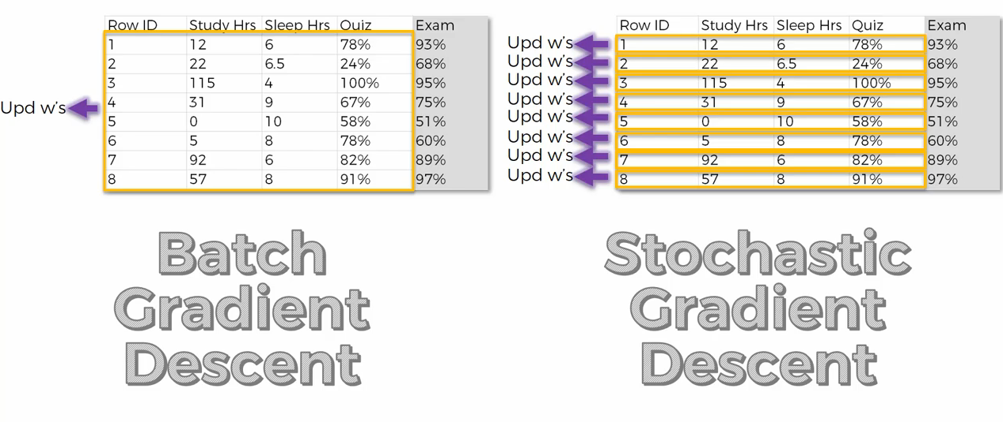
Stochastic gradient descent
For further assistance, code and slide https://fahadhussaincs.blogspot.com/
YouTube Channel : https://www.youtube.com/fahadhussaintutorial

Slide 45
Thank You!
For further assistance, code and slide https://fahadhussaincs.blogspot.com/
YouTube Channel : https://www.youtube.com/fahadhussaintutorial

Slide 46
Mini Batch gradient descent
Mini-batch gradient descent is a variation of the gradient descent algorithm that splits the training dataset into small batches that are used to calculate model error and update model coefficients.
Implementations may choose to sum the gradient over the mini-batch which further reduces the variance of the gradient.
Mini-batch gradient descent seeks to find a balance between the robustness of stochastic gradient descent and the efficiency of batch gradient descent. It is the most common implementation of gradient descent used in the field of deep learning.
For further assistance, code and slide https://fahadhussaincs.blogspot.com/
YouTube Channel : https://www.youtube.com/fahadhussaintutorial

Slide 47
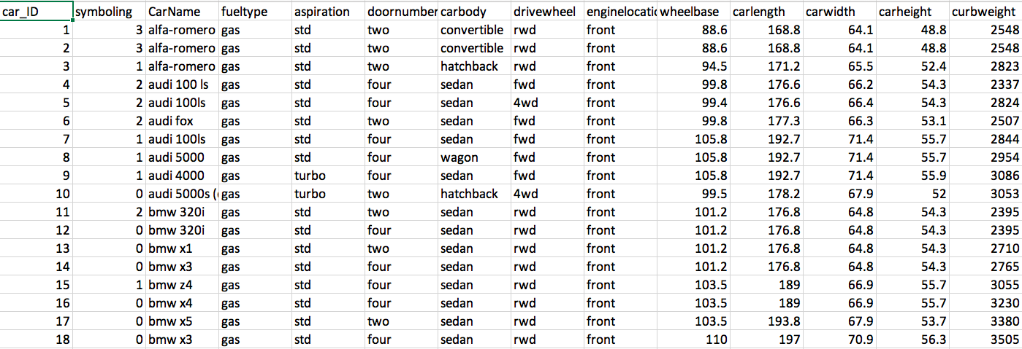
Mini Batch gradient descent
BGD SGD MBGD
For further assistance, code and slide https://fahadhussaincs.blogspot.com/
YouTube Channel : https://www.youtube.com/fahadhussaintutorial

Slide 48
Thank You!
For further assistance, code and slide https://fahadhussaincs.blogspot.com/
YouTube Channel : https://www.youtube.com/fahadhussaintutorial

Slide 49
Different types of Neural Network
Perceptron (Multilayer Perceptron) & ANN
Feedforward Neural Network – Artificial Neuron
Radial Basis Function Neural Network
Convolutional Neural Network
Recurrent Neural Network(RNN) –Long Short Term Memory
For further assistance, code and slide https://fahadhussaincs.blogspot.com/
YouTube Channel : https://www.youtube.com/fahadhussaintutorial

Slide 50
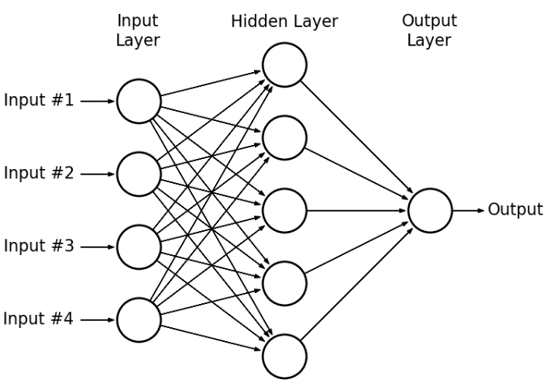
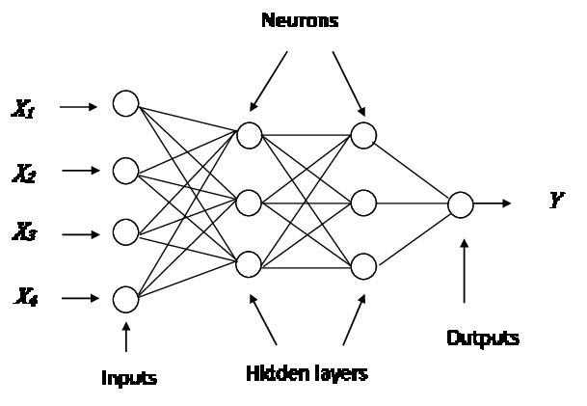
Perceptron (Multilayer Perceptron) & ANN
A perceptron is a network with two layers, one input and one output. ... Artificial neural network, which has input layer, output layer, and two or more trainable weight layers (constisting of Perceptrons) is called multilayer perceptron or MLP
For further assistance, code and slide https://fahadhussaincs.blogspot.com/
YouTube Channel : https://www.youtube.com/fahadhussaintutorial

Slide 51
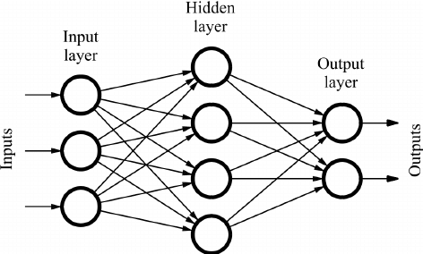
Feedforward Neural Network
It is one of the simplest types of artificial neural networks. In a feedforward neural network, the data passes through different input nodes until it reaches the output node. In other words, the data moves in only one direction from the first range until it reaches the output node. It is also known as a front propagating wave which is usually obtained using a graded activation function. Unlike more complex types of neural networks, backpropagation and data move in only one direction. A feedforward neural network may consist of a single layer or may contain hidden layers. In a feedful neural network, the products of the inputs and their weights are calculated. This is then fed to the output.
whereas
Backpropagation is a training algorithm consisting of 2 steps:
Feedforward the values.
Calculate the error and propagate it back to the earlier layers.
For further assistance, code and slide https://fahadhussaincs.blogspot.com/
YouTube Channel : https://www.youtube.com/fahadhussaintutorial

Slide 52
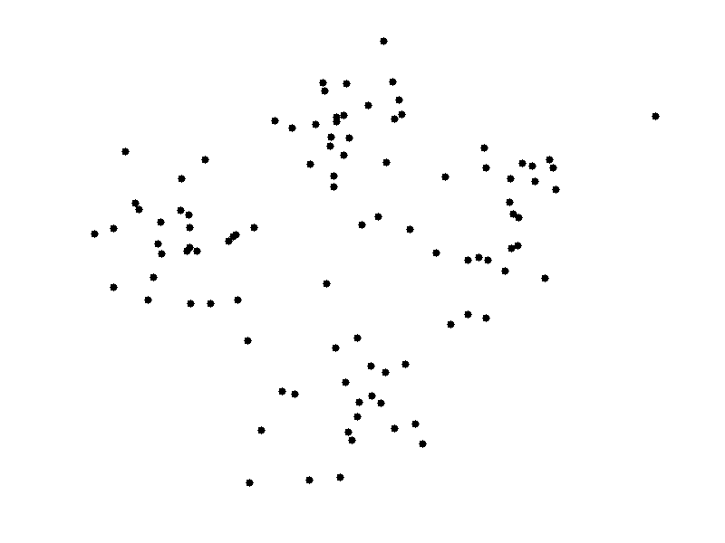
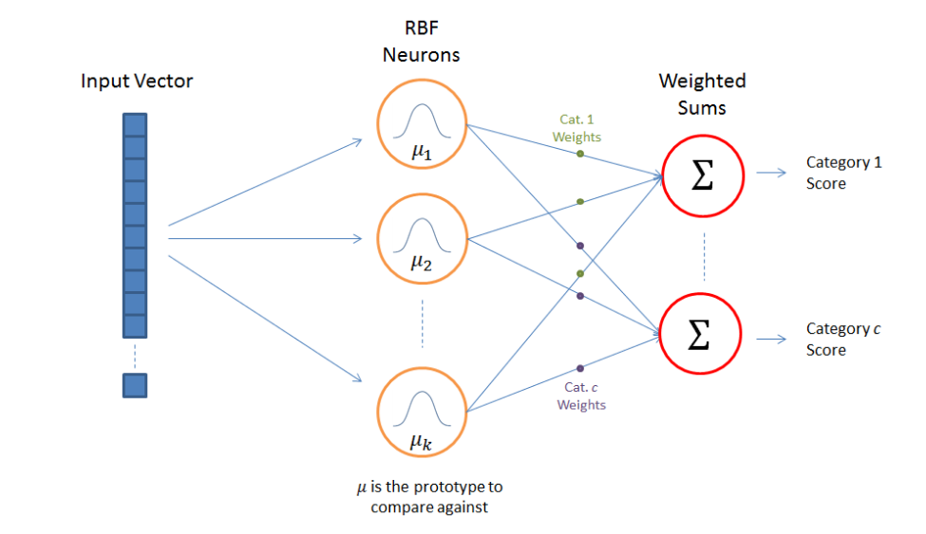
Radial Basis Function Neural Network
A radial basis function (RBF) is a function that assigns a real value to each input from its domain (it is a real-value function), and the value produced by the RBF is always an absolute value; i.e. it is a measure of distance and cannot be negative.
f(x) = f(||x||)
Euclidean distance, the straight-line distance between two points in Euclidean space, is typically used. Radial basis functions are used to approximate functions, much as neural networks act as function approximators.
RBF network represents a radial basis function network. The radial basis functions act as activation functions.
The approximant f(x) is differentiable with respect to the weights W, which are learned using iterative updater methods coming among neural networks.
Radial basis function neural networks are extensively applied in power restoration systems. In recent decades, power systems have become larger and more complex.
This increases the risk of blackout. This neural network is used in power restoration systems to restore power in the least amount of time.

Slide 53
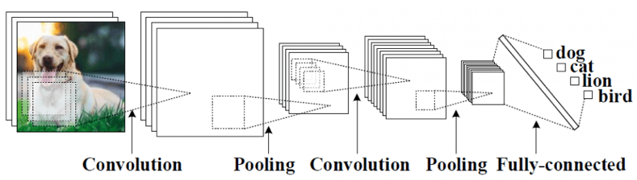
Convolutional Neural Network
Convolutional Neural Networks (CNN) is one of the variants of neural networks used heavily in the field of Computer Vision. It derives its name from the type of hidden layers it consists of. The hidden layers of a CNN typically consist of convolutional layers, pooling layers, fully connected layers, and normalization layers. Here it simply means that instead of using the normal activation functions defined above, convolution and pooling functions are used as activation functions.
For further assistance, code and slide https://fahadhussaincs.blogspot.com/
YouTube Channel : https://www.youtube.com/fahadhussaintutorial

Slide 54
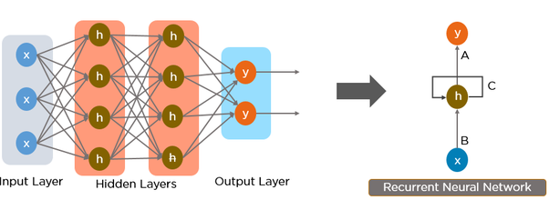
Recurrent Neural Network
Recurrent Neural Network(RNN) are a type of Neural Network where the output from previous step are fed as input to the current step. In traditional neural networks, all the inputs and outputs are independent of each other, but in cases like when it is required to predict the next word of a sentence, the previous words are required and hence there is a need to remember the previous words. Thus RNN came into existence, which solved this issue with the help of a Hidden Layer. The main and most important feature of RNN is Hidden state, which remembers some information about a sequence.
For further assistance, code and slide https://fahadhussaincs.blogspot.com/
YouTube Channel : https://www.youtube.com/fahadhussaintutorial

Slide 55
Thank You!
For further assistance, code and slide https://fahadhussaincs.blogspot.com/
YouTube Channel : https://www.youtube.com/fahadhussaintutorial

Slide 56
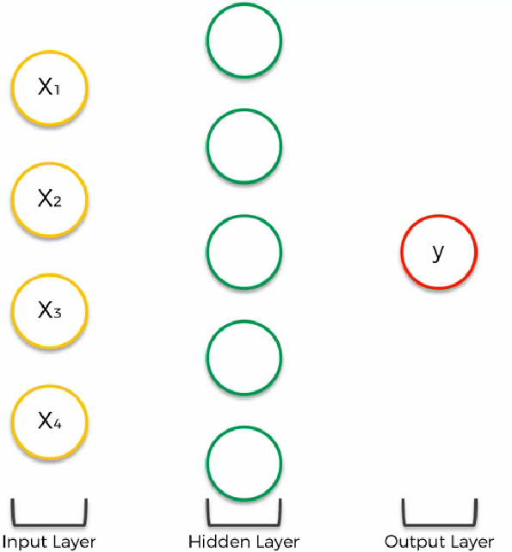
Artificial neural network working principle
For further assistance, code and slide https://fahadhussaincs.blogspot.com/
YouTube Channel : https://www.youtube.com/fahadhussaintutorial

Slide 57

Artificial neural network working principle
For further assistance, code and slide https://fahadhussaincs.blogspot.com/
YouTube Channel : https://www.youtube.com/fahadhussaintutorial

Slide 58
Artificial neural network working Step by Step
STEP 1: Randomly initialize the weights to small numbers close to 0 (but not 0)
STEP 2: Input the first observation of your dataset in the input layer, each feature in one input node.
STEP 3: Forward-Propagation: from left to right, the neurons are activated in a way that the impact of each neuron's activation is limited by the weights. Propagate the activations until getting the predicted result y.
STEP 4: Compare the predicted result to the actual result. Measure the generated error.
STEP 5: Back-Propagation: from right to left, the error is back-propagated.
Update the weights according to how much they are responsible for the error. The learning rate decides by how much we update the weights.
STEP 6: Repeat Steps 1 to 5 and update the weights after each observation (Reinforcement Learning).
Or: Repeat Steps 1 to 5 but update the weights only after a batch of observations (Batch Learning).
For further assistance, code and slide https://fahadhussaincs.blogspot.com/
YouTube Channel : https://www.youtube.com/fahadhussaintutorial

Slide 59
Keras
Keras is a high-level neural networks API, written in Python and capable of running on top of TensorFlow, CNTK, or Theano. It was developed with a focus on enabling fast experimentation. Being able to go from idea to result with the least possible delay is key to doing good research.
Use Keras if you need a deep learning library that:
Allows for easy and fast prototyping (through user friendliness, modularity, and extensibility).
Supports both convolutional networks and recurrent networks, as well as combinations of the two.
Runs seamlessly on CPU, GPU and TPU.
For further assistance, code and slide https://fahadhussaincs.blogspot.com/
YouTube Channel : https://www.youtube.com/fahadhussaintutorial

Slide 60
TensorFlow
TensorFlow is a free and open-source software library for dataflow and differentiable programming across a range of tasks. It is a symbolic math library, and is also used for machine learning applications such as neural networks. Wikipedia
Now its time to,
Practical Working on Google COLAB
For further assistance, code and slide https://fahadhussaincs.blogspot.com/
YouTube Channel : https://www.youtube.com/fahadhussaintutorial

Slide 61
Thank You!
For further assistance, code and slide https://fahadhussaincs.blogspot.com/
YouTube Channel : https://www.youtube.com/fahadhussaintutorial

Slide 62
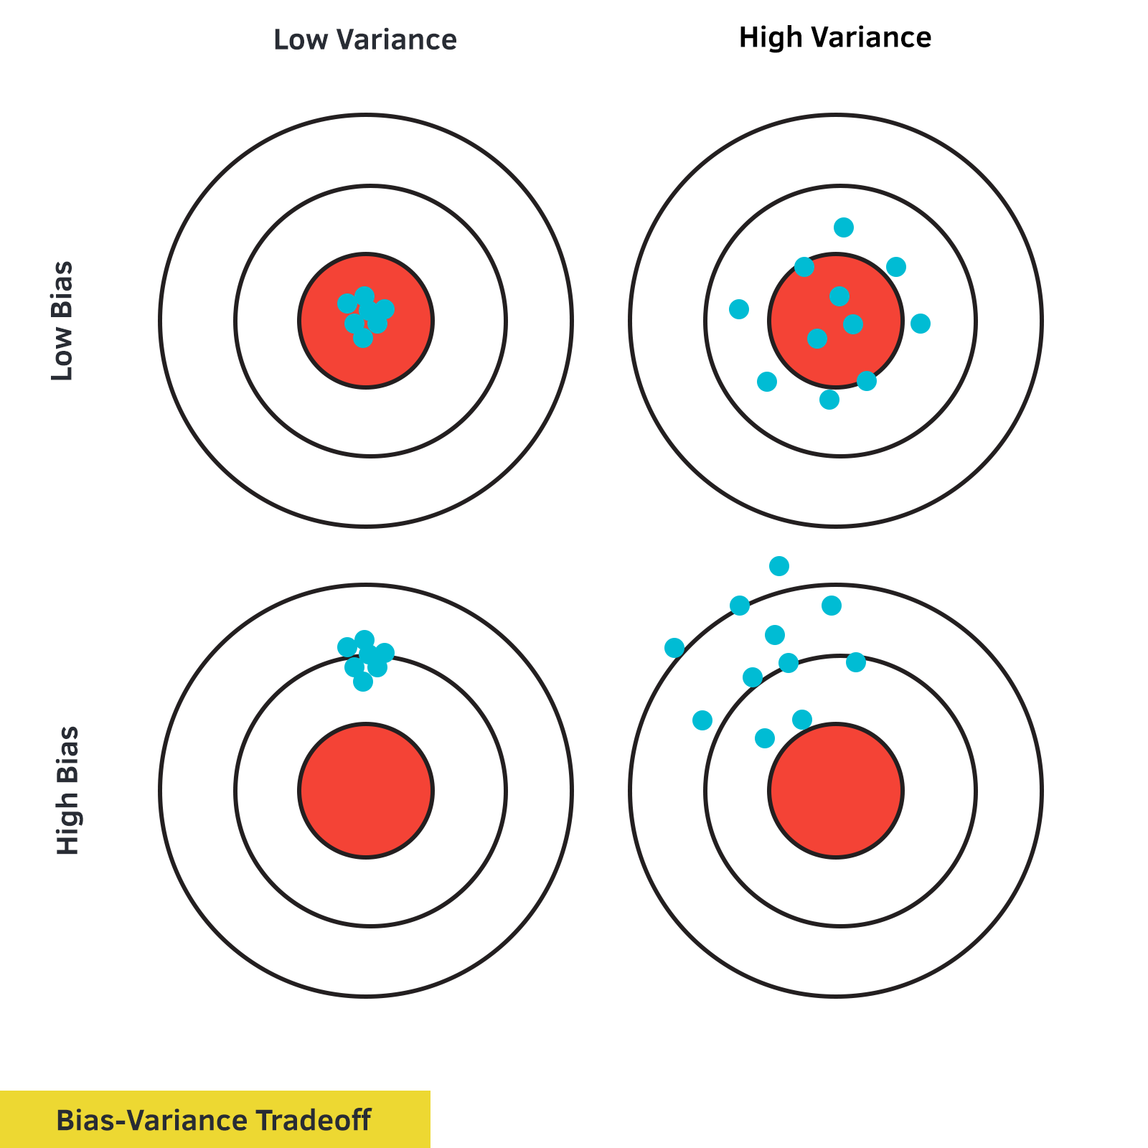

Slide 63
To Handle Overfitting Problem
Bias and Variance Problem (tradeoff)
irreducible Error
Regularization (L1 Ridge Regression , L2 Lasso Regression
Drop out Method (Regularization)
For further assistance, code and slide https://fahadhussaincs.blogspot.com/
YouTube Channel : https://www.youtube.com/fahadhussaintutorial

Slide 64
What is Bias and Variance
For further assistance, code and slide https://fahadhussaincs.blogspot.com/
YouTube Channel : https://www.youtube.com/fahadhussaintutorial

Slide 65

Underfitting and Overfitting (Bias and Variance)
For further assistance, code and slide https://fahadhussaincs.blogspot.com/
YouTube Channel : https://www.youtube.com/fahadhussaintutorial

Slide 66
So, What will be the best model
Low Bias, Low Variance

Slide 67
So, what about the irreducible Error, actually it is errors in data collected at the source. Noisiness and outlies introduced at source level from data collected!
Thanks
Helpful link:
https://towardsdatascience.com/holy-grail-for-bias-variance-tradeoff-overfitting-underfitting-7fad64ab5d76
First we create the K fold in Breast Cancer dataset first then, we understand the others Regularization then finally we move towards the Parameters Tuning…

Slide 68
Regularization,
(L2) Ridge Regression
(L1) Lasso Regression
Regularization is a process of introducing additional information in order to prevent overfitting.
For further assistance, code and slide https://fahadhussaincs.blogspot.com/
YouTube Channel : https://www.youtube.com/fahadhussaintutorial

Slide 69
Thanks
For further assistance, code and slide https://fahadhussaincs.blogspot.com/
YouTube Channel : https://www.youtube.com/fahadhussaintutorial

Slide 70
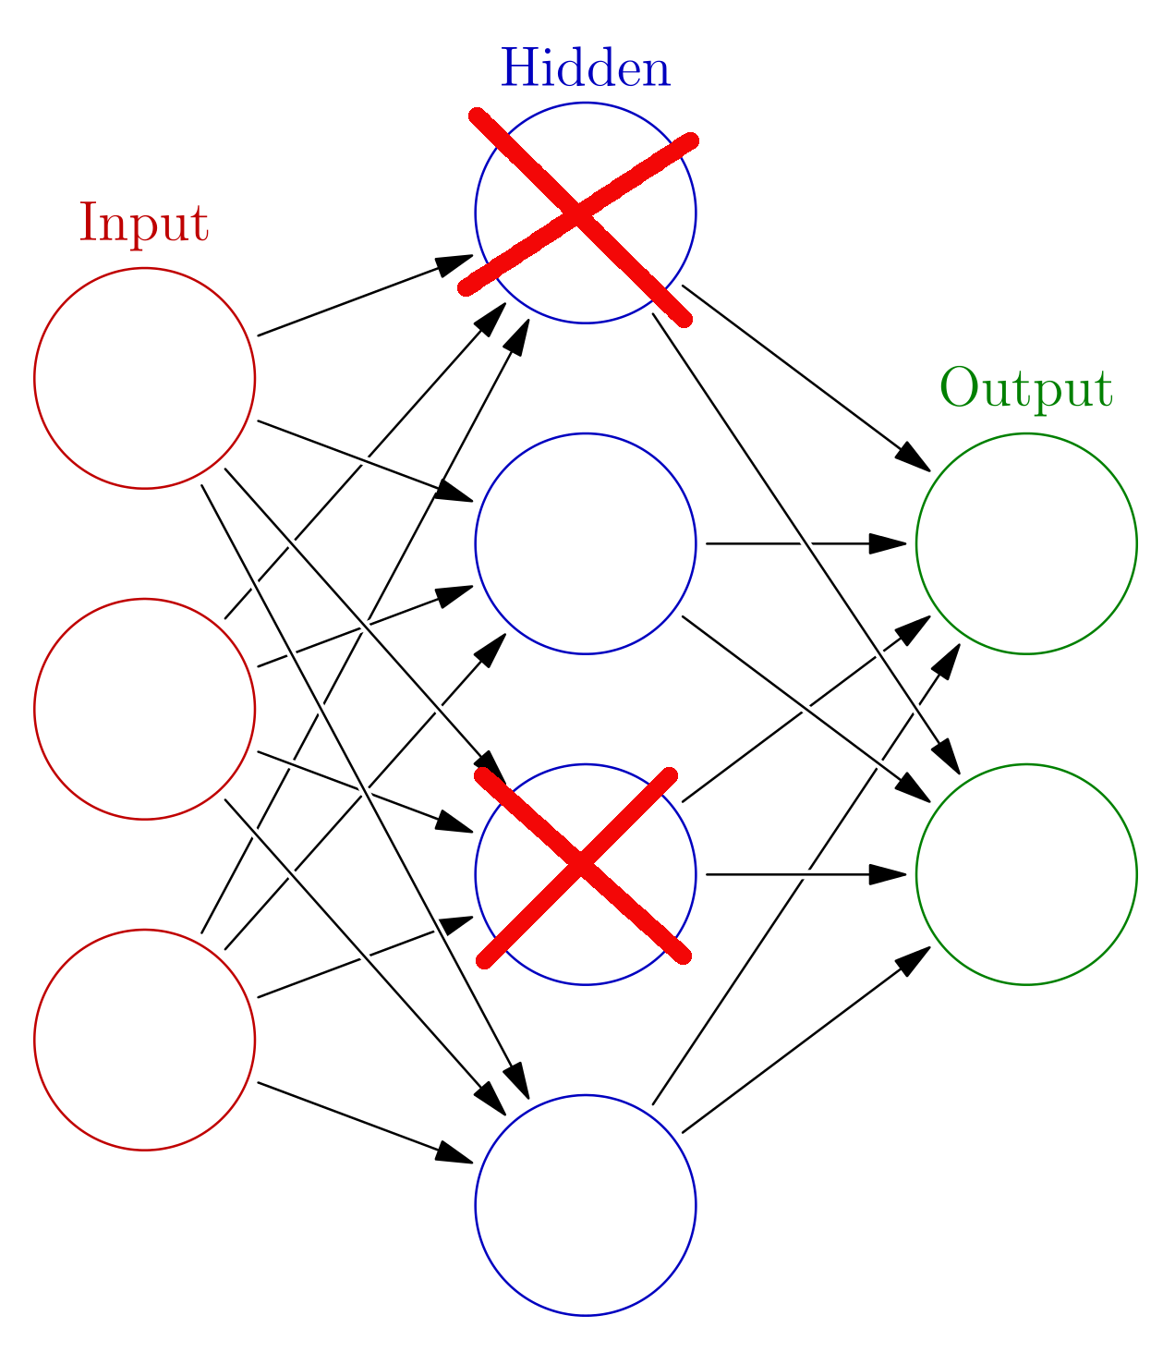
Drop out Method (Regularization)
Drop out ratio
0 <= p >= 1
Eg: = 0.2
For further assistance, code and slide https://fahadhussaincs.blogspot.com/
YouTube Channel : https://www.youtube.com/fahadhussaintutorial

Slide 71
Thanks
For further assistance, code and slide https://fahadhussaincs.blogspot.com/
YouTube Channel : https://www.youtube.com/fahadhussaintutorial

Slide 72
Parameters Tuning in ANN
Parameter VS Hyper-parameters
Model Parameters are something that a model learns on its own. For example,
1) Weights or Coefficients of independent variables in Linear regression model.
2) Weights or Coefficients of independent variables SVM.
3) Split points in Decision Tree.
Model hyper-parameters are used to optimize the model performance. For example
1)Kernel and slack in SVM
2)Value of K in KNN
3)Depth of tree in Decision trees.
For further assistance, code and slide https://fahadhussaincs.blogspot.com/
YouTube Channel : https://www.youtube.com/fahadhussaintutorial

Slide 73
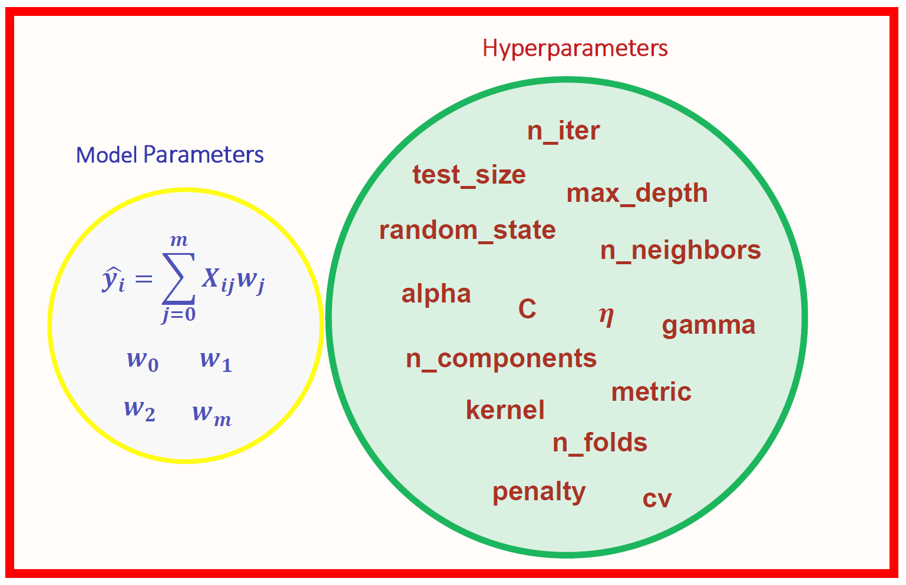
Parameters Tuning in ANN
Parameter VS Hyper-parameters
Lets understand the this Hyper parameters (optimal) size or quantity in ANN using Parameter Tuning!
For further assistance, code and slide https://fahadhussaincs.blogspot.com/
YouTube Channel : https://www.youtube.com/fahadhussaintutorial

Slide 74
Parameters Tuning in ANN
Parameter VS Hyper-parameters
Grid searching of hyperparameters
Grid search is an approach to hyperparameter tuning that will methodically build and evaluate a model for each combination of algorithm parameters specified in a grid.
For further assistance, code and slide https://fahadhussaincs.blogspot.com/
YouTube Channel : https://www.youtube.com/fahadhussaintutorial

Slide 75
Thanks
For further assistance, code and slide https://fahadhussaincs.blogspot.com/
YouTube Channel : https://www.youtube.com/fahadhussaintutorial

Slide 76
What is Optimizer and different types it!
Optimizers are algorithms or methods used to change the attributes of your neural network such as weights and learning rate in order to reduce the losses.
Optimization algorithms or strategies are responsible for reducing the losses and to provide the most accurate results possible
Role of an optimizer
Optimizers update the weight parameters to minimize the loss function. Loss function acts as guides to the terrain telling optimizer if it is moving in the right direction to reach the bottom of the valley, the global minimum.
For further assistance, code and slide https://fahadhussaincs.blogspot.com/
YouTube Channel : https://www.youtube.com/fahadhussaintutorial

Slide 77
What is Optimizer and different types it!
Types of Gradient Descent: Different types of Gradient descents are
Batch Gradient Descent or Vanilla Gradient Descent
Stochastic Gradient Descent
Mini batch Gradient Descent
For further assistance, code and slide https://fahadhussaincs.blogspot.com/
YouTube Channel : https://www.youtube.com/fahadhussaintutorial

Slide 78
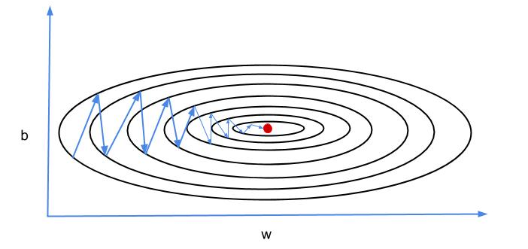
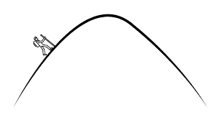
Gradient Descent with Momentum
Mini-batch gradient descent makes a parameter update with just a subset of examples, the direction of the update has some variance, and so the path taken by mini-batch gradient descent will “oscillate” toward convergence. Gradient Descent with Momentum considers the past gradients to smooth out the update. It computes an exponentially weighted average of your gradients, and then use that gradient to update your weights instead. It works faster than the standard gradient descent algorithm.
Gradient Descent with Momentum considers the past gradients to smooth out the update. It computes an exponentially weighted average of your gradients, and then use that gradient to update your weights instead.

Slide 79
Gradient Descent with Momentum
During backward propagation, we use dW and db to update our parameters W and b as follows:
W = W – learning rate * dW
b = b – learning rate * db
In momentum, instead of using dW and db independently for each epoch, we take the exponentially weighted averages of dW and db.
V_{dW} = β x V_{dW} + (1 – β) x dW
V_{db} = β x V_{db} + (1 – β) x db
Where beta ‘β’ is another hyperparameter called momentum and ranges from 0 to 1. It sets the weight between the average of previous values and the current value to calculate the new weighted average.
After calculating exponentially weighted averages, we will update our parameters.
W = W – learning rate *V_{dW}
b = b – learning rate * V_{db}
For further assistance, code and slide https://fahadhussaincs.blogspot.com/
YouTube Channel : https://www.youtube.com/fahadhussaintutorial

Slide 80
Link:
https://medium.com/datadriveninvestor/overview-of-different-optimizers-for-neural-networks-e0ed119440c3
Research Paper:
A Survey of Optimization Methods from a Machine Learning Perspective
Thanks
For further assistance, code and slide https://fahadhussaincs.blogspot.com/
YouTube Channel : https://www.youtube.com/fahadhussaintutorial

Slide 81
Adagrad Optimizer
Adagrad is an optimizer with parameter-specific learning rates, which are adapted relative to how frequently a parameter gets updated during training. The more updates a parameter receives, the smaller the learning rate.
AdaGrad or adaptive gradient allows the learning rate to adapt based on parameters. It performs larger updates for infrequent parameters and smaller updates for frequent one. Because of this it is well suited for sparse data (NLP or image recognition). Another advantage is that it basically eliminates the need to tune the learning rate. Each parameter has its own learning rate and due to the peculiarities of the algorithm the learning rate is monotonically decreasing. This causes the biggest problem: at some point of time the learning rate is so small that the system stops learning
Two Features in Learning stage in (NN)
Dense (Matrix) most of value in matrix is NOT zero (0)
Sparse (Matrix) most of value in matrix is zero (0)
taking cumulative sum of squared gradients

Slide 82
Link:
https://medium.com/datadriveninvestor/overview-of-different-optimizers-for-neural-networks-e0ed119440c3
Research Paper:
A Survey of Optimization Methods from a Machine Learning Perspective
Thanks
For further assistance, code and slide https://fahadhussaincs.blogspot.com/
YouTube Channel : https://www.youtube.com/fahadhussaintutorial

Slide 83
Adadelta & RMSProp Optimizer
RMSprop
Root mean square prop or RMSprop is another adaptive learning rate that is an improvement of AdaGrad. Instead of taking cumulative sum of squared gradients like in AdaGrad, we take the exponential moving average of these gradients.
For further assistance, code and slide https://fahadhussaincs.blogspot.com/
YouTube Channel : https://www.youtube.com/fahadhussaintutorial

Slide 84
Like RMSprop, Adadelta (2012) is also another improvement from AdaGrad, focusing on the learning rate component. Adadelta is probably short for ‘adaptive delta’, where delta here refers to the difference between the current weight and the newly updated weight.
The difference between Adadelta and RMSprop is that Adadelta removes the use of the learning rate parameter completely by replacing it with D, the exponential moving average of squared deltas.
For further assistance, code and slide https://fahadhussaincs.blogspot.com/
YouTube Channel : https://www.youtube.com/fahadhussaintutorial

Slide 85
Link:
https://medium.com/datadriveninvestor/overview-of-different-optimizers-for-neural-networks-e0ed119440c3
Research Paper:
A Survey of Optimization Methods from a Machine Learning Perspective
Thanks
For further assistance, code and slide https://fahadhussaincs.blogspot.com/
YouTube Channel : https://www.youtube.com/fahadhussaintutorial

Slide 86
Adaptive moment estimation, or Adam Optimizer
Adaptive moment estimation, or Adam (2014), is a combination of momentum and RMSprop.
It acts upon,
The gradient component by using V, the exponential moving average of gradients (like in momentum) and
(ii) The learning rate component by dividing the learning rate α by square root of S, the exponential moving average of squared gradients (like in RMSprop).
For further assistance, code and slide https://fahadhussaincs.blogspot.com/
YouTube Channel : https://www.youtube.com/fahadhussaintutorial

Slide 87
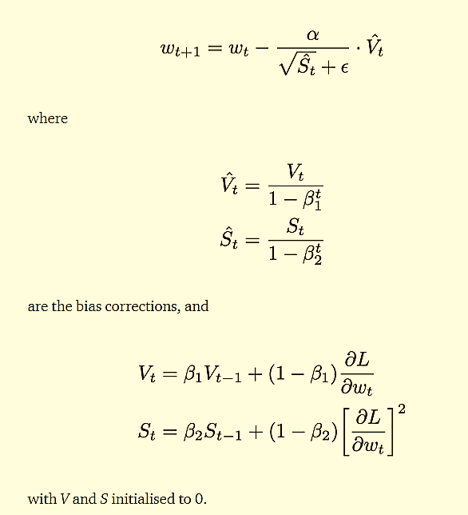
W = W – learning rate * dW
V_{dW} = β x V_{dW} + (1 – β) x dW
V_{db} = β x V_{db} + (1 – β) x db
For further assistance, code and slide https://fahadhussaincs.blogspot.com/
YouTube Channel : https://www.youtube.com/fahadhussaintutorial

Slide 88
Thanks
For further assistance, code and slide https://fahadhussaincs.blogspot.com/
YouTube Channel : https://www.youtube.com/fahadhussaintutorial

Slide 89
Converulation neural network (CNN)
But understanding first understand the two core field of A.I
Image Processing
Computer vision
Image processing is a method to perform some operations on an image, in order to get an enhanced image or to extract some useful information from it. It is a type of signal processing in which input is an image and output may be image or characteristics/features associated with that image. Nowadays, image processing is among rapidly growing technologies. It forms core research area within engineering and computer science disciplines too.
Computer Vision, often abbreviated as CV, is defined as a field of study that seeks to develop techniques to help computers “see” and understand the content of digital images such as photographs and videos.
For further assistance, code and slide https://fahadhussaincs.blogspot.com/
YouTube Channel : https://www.youtube.com/fahadhussaintutorial

Slide 90
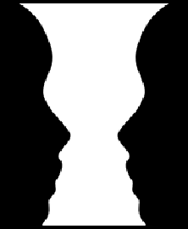
Converulation neural network (CNN)
So, what is CNN
For further assistance, code and slide https://fahadhussaincs.blogspot.com/
YouTube Channel : https://www.youtube.com/fahadhussaintutorial

Slide 91

Converulation neural network (CNN)
So, what is CNN
For further assistance, code and slide https://fahadhussaincs.blogspot.com/
YouTube Channel : https://www.youtube.com/fahadhussaintutorial

Slide 92
Converulation neural network (CNN)
So, what is CNN
A convolutional neural network (CNN) is a specific type of artificial neural network that uses perceptrons, a machine learning unit algorithm, for supervised learning, to analyze data. CNNs apply to image processing, natural language processing and other kinds of cognitive tasks.
For further assistance, code and slide https://fahadhussaincs.blogspot.com/
YouTube Channel : https://www.youtube.com/fahadhussaintutorial

